Slide 1
Database
Meeting June 11, 2024

Slide 2
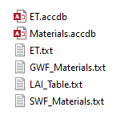
Database files

Slide 3
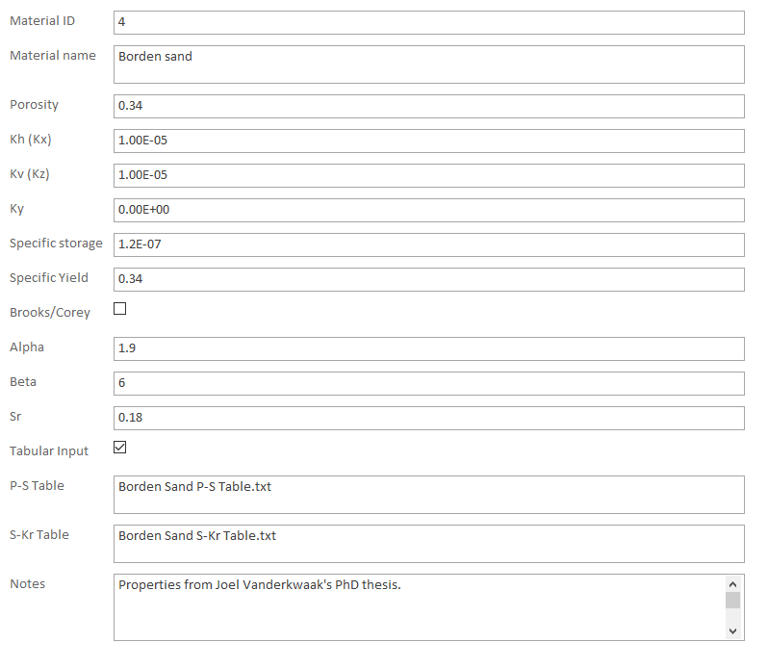
GWF Material Properties
Ky here if we want to use the kx, ky, kz approach
If checked, table would be generated from equations
Modflow uses a single table. Some examples of existing tables would be helpful.

Slide 4
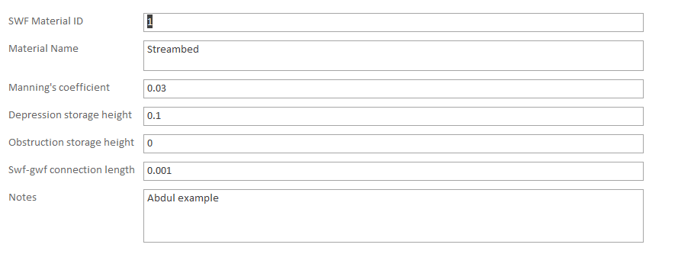
SWF Material Properties
This is the current database structure
# ISWFTYP SMANN SWFH1 SWFH2
1 3.00000E-02 1.00000E-06 1.00000E-06
2 0.30000 1.00000E-06 1.00000E-06
These are the current Modflow SWF zoned properties in input .swf file
We can finalize which variables are zoned etc when initial Panday verification example is provided
For example, should connection length, swfh1 and swfh2 be zoned or single global parameters?

Slide 5
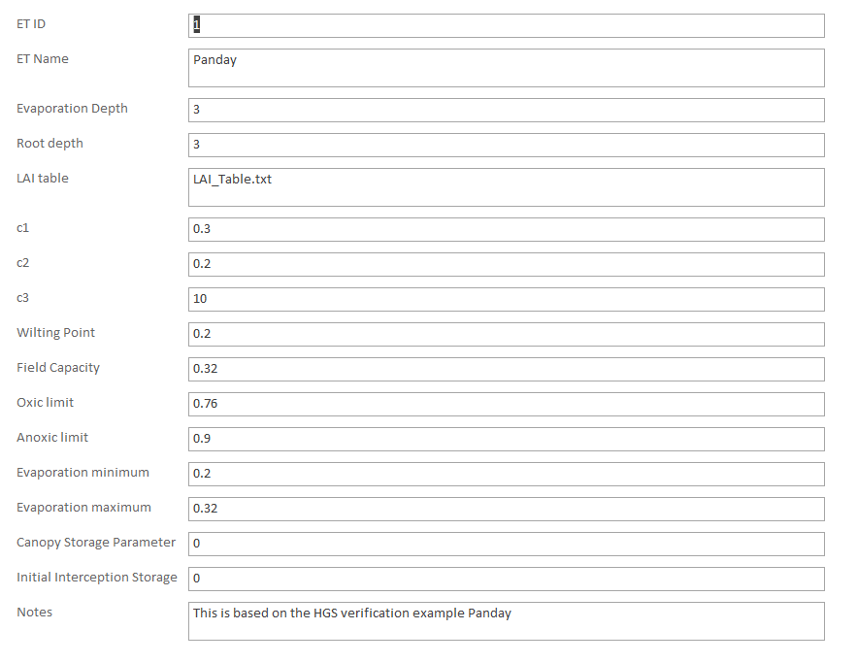
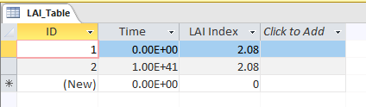
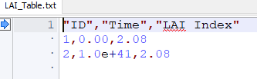
ET Zone Properties
These are based on the inputs from the HGS verification example Panday
This basic LAI Table can be modfied and renamed for other situations
LAI tables are exported as txt files for Modflow input

Slide 6
Next Steps
Finalize SWF and ET Database inputs
SMS inputs
User’s Guide
Implement a 2D (template) face/neighbour/element scheme in fortran instead of using Tecplot
Current Tecplot approach doesn’t work for CLN or Quadtree
Implement kriging and rasters in pre-processor for surface elevations
Implement outer boundary import to use as mesh cookie cutter in pre-processor
Make sure all examples can be built in pre-processor
User-defined zones

